Slide 1


Aibrary

Slide 2
01 / Platform Overview
Radically accessible microlearning turning downtime into active self-growth across 160+ countries

Slide 3



Agentic AI Audio Learning
Science-Backed Pedagogies
Aibrary transforms non-fiction bestsellers and expert knowledge into engaging 10–15 minute podcast-style audio segments. Designed for busy professionals to learn while commuting or taking breaks.
Built upon proven educational psychology frameworks, including Vygotsky's Zone of Proximal Development, shifting passive audio listening into active knowledge mastering.

Slide 4

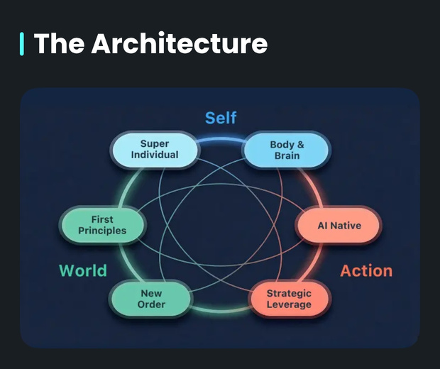
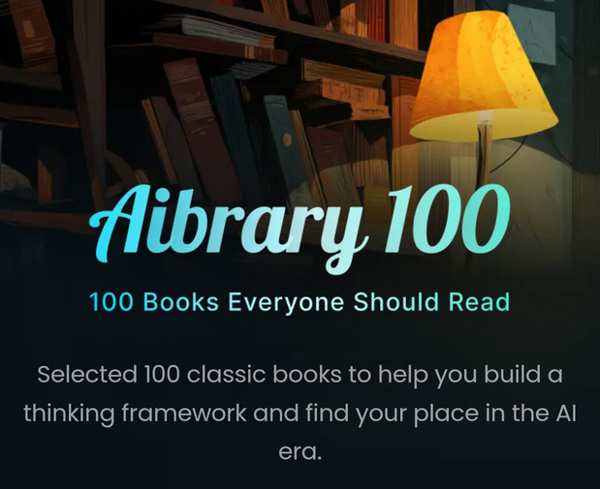
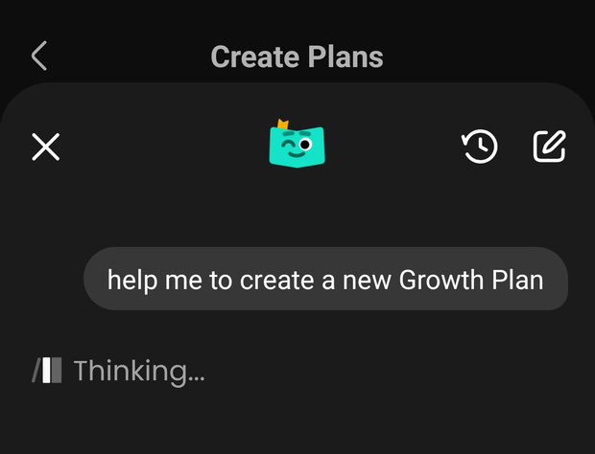
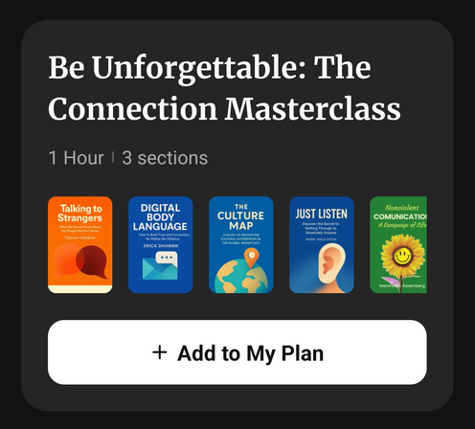
Key Platform Features
"For You" Smart Feed: On-demand, hyper-personalized audio streams tailored daily to your career & life goals.
Idea Twin: Interactive cognitive mirror allowing you to debate concepts with AI experts in your own voice.
Aibrary 100: Selected 100 classic books to help you build a thinking framework and find your place in the Al era.
3 Ways to Learn: Flexible options per book—Quick Summaries, Curated Podcasts, and Idea Twin.

Slide 5




AI Growth Team Mentors
Nova
Orion
Atlas
Chief Growth Officer: Mentors your mindset, habits, resilience, and personal development goals.
Chief Knowledge Officer: Curates deep research, facts, and essential takeaways from non-fiction titles.
Chief Action Officer: Translates insights into daily execution, habit streaks, and accountability plans.

Slide 6
02 / Impact & Metrics
Empowering global learners through the Global Learners' Collective & Ambassador initiatives

Slide 7

Impact & Reach
Driving Global Engagement
160+
In partnership with programs like the Aspire Institute, Aibrary brings world-class knowledge to first-generation students and leaders worldwide. Interactive features like daily streaks and community challenges keep learners consistently engaged.
Countries Supported

Slide 8
03 / Feature Suggestion
Progressive Matrix: Elevating reader decision-making and content preview

Slide 9





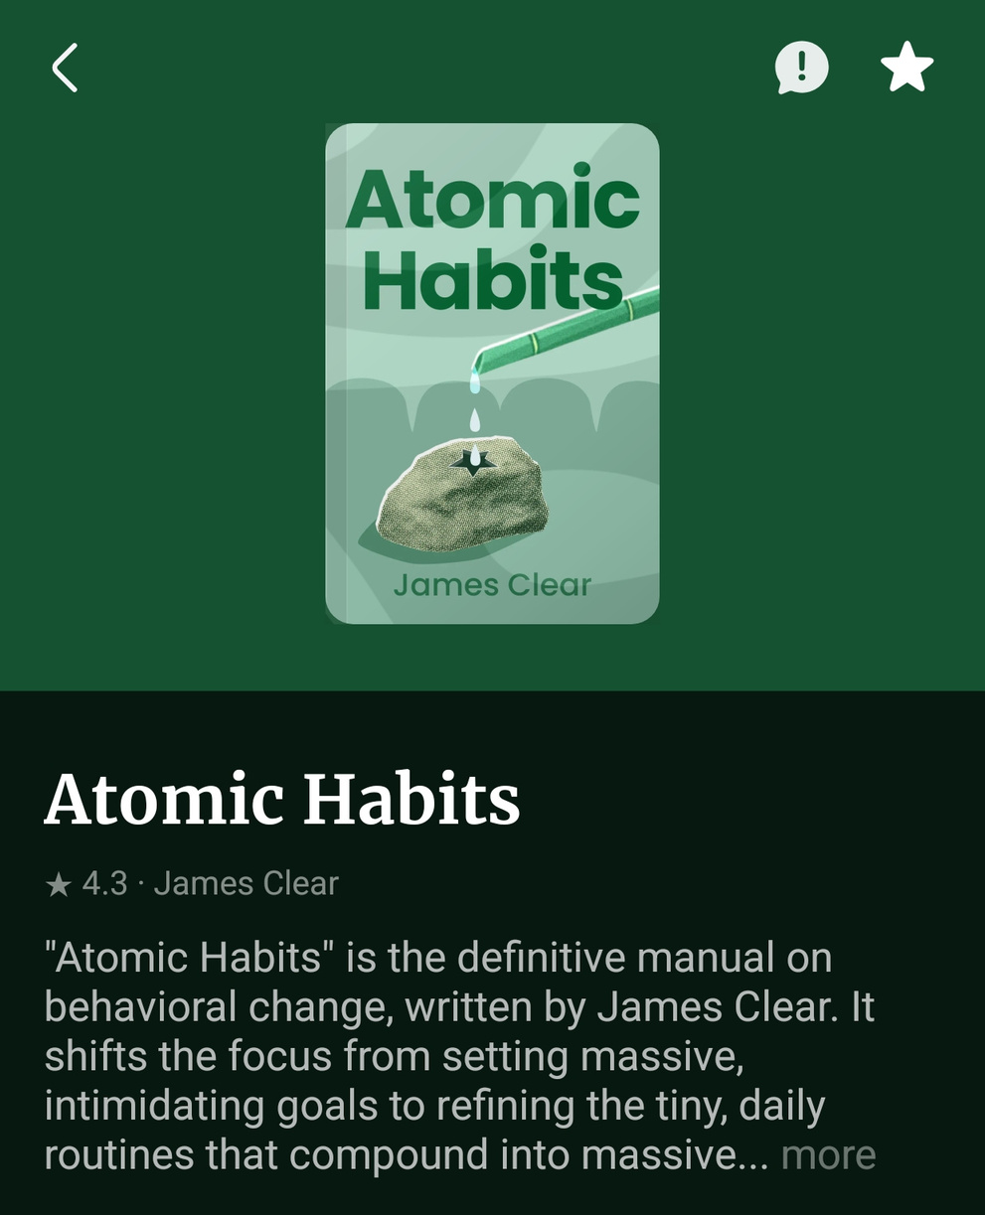



The Progressive Matrix
THEMATIC PILLARS
DIFFICULTY LEVEL
Low (2/5)
Highly accessible & practical for all learners.
ACTIONABILITY SCORE
CORE TAKEAWAY
9.5
/ 10
"Small 1% daily habits compound into massive, transformative long-term growth."
Immediate, real-world execution tools.

Slide 10
Matrix Mechanics & Value
How It Works
User & Platform Value
Generates a 3x3 visual breakdown highlighting: Core Argument, Practical Applications, and Prerequisite Ideas. Users can tap matrix cells for 15-second teaser audio clips.
Eliminates decision fatigue for busy listeners, increases completion rates for recommended podcasts, and enhances personalization within the "For You" Smart Feed algorithm.

Slide 11



Feature Roadmap
Q2 - Ambassador Beta
Q4 - Smart Feed Sync
Roll out preview matrix to Aibrary Ambassadors for qualitative feedback.
Feed user matrix interaction data back into Nova and Orion algorithms.
Q1 - UX Design
Q3 - App Rollout
Wireframe Progressive Matrix UI and test tap-to-preview audio teasers.
Integrate matrix view into book detail pages for iOS and Android apps.

Slide 12
Thankyou
Global Learner's Collective Ambassador
Aspire X Aibrary

